Slide 1
Gaussian Mixture Models
And their training with the EM algorithm

Slide 2
Introduction
We saw how to fit Gaussian curves on data samples
But the Gaussian curve as a model is not really a flexible
  The distribution of real data rarely have a Gaussian shape
  So the „model error” will be large
Today we introduce a new model called the Gaussian Mixture Model
  It has a much more flexible shape than a simple Gaussian
  But, unfortunately, it will be much more difficult to train
    We will use the Maximum likelihood target function, as before
    But, instead of a closed form solution, we will introduce an iterative algorithm to optimize its parameters. This will be the EM algorithm
We will again train the model of the different classes separately
  So we will talk about how to fit the model on the samples of one class, and drop the condition c_{i} from the notation
    but don’t forget that the process should be repeated for all classes

Slide 3
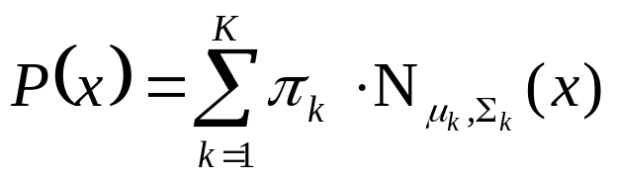
The Gaussian Mixture Model (GMM)
We will estimate p(x) as a weighted sum of Gaussians
Formally:
  When N denotes the normal (or Gaussian) distribution
  The π_{k} weights are non-negative and add up to 1
  The number K of the Gaussians is fixed (but it could be optimized as well)
By increasing the number of components the curve defined by the mixture model can take basically any shape, so it is much more flexible than just one Gaussian
  Examples:
  https://www.slideshare.net/butest/lecture-18-gaussian-mixture-models-and-expectation-maximization

Slide 4
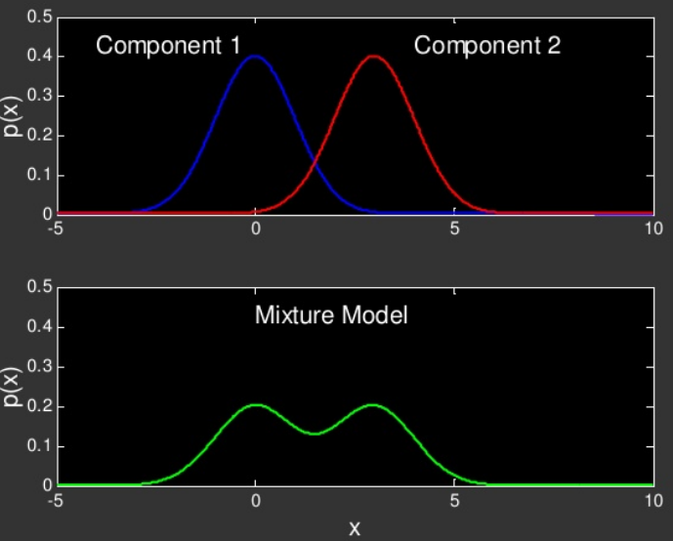
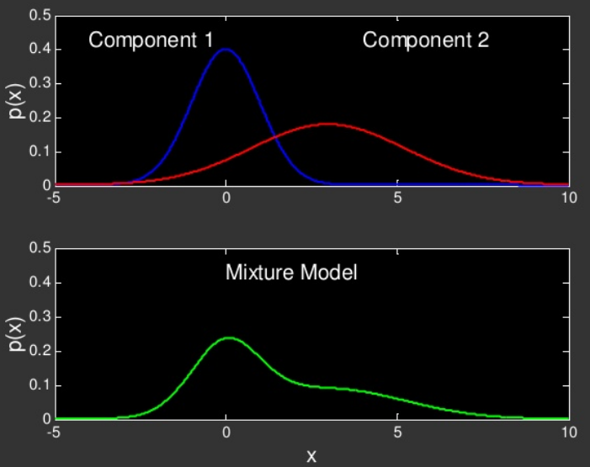
Examples #1

Slide 5
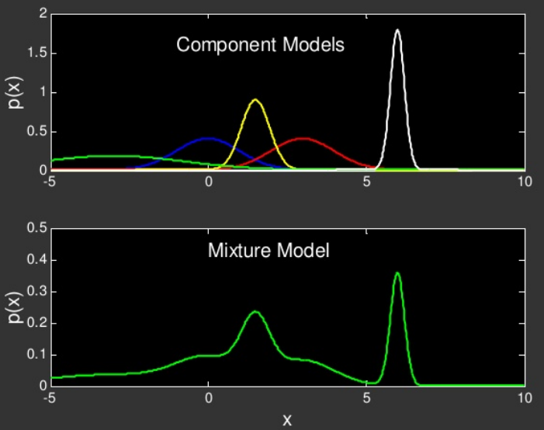
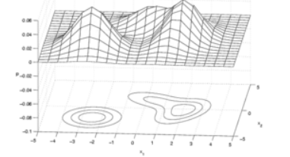
Examples #2

Slide 6
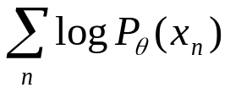
Parameter estimation for GMMs
The parameters of the model are π_{k} , μ_{k} and Σ_{k} for all components (k=1,..,K). Sometimes we will again use a short notation for all the parameters: θ=(π₁, μ₁ , Σ₁,…, π_{K}, μ_{K} , Σ_{K})
We again seek to maximize the log-likelihood function:
When p(x) was just a Gaussian curve, we could simply take its derivative and find its zero point
Unfortunately, obtaining the derivative of the mixture model is much more difficult
  So we will need some other solution – this will be the EM algorithm

Slide 7
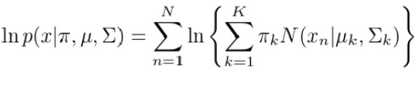

Parameter estimation for GMMs
Let’s take the log-likelihood function
And try to set its derivative to zero (e.g. with respect to μ_{k}):
It doesn’t work ☹
  In the case of just one Gaussian, the logarithm helped get rid of the exponential function
  But now there is a summation between the logarithm and the exponential
This is the problem
(it contains μ_{k})
Derivative of 1 Gaussian (same as before)

Slide 8
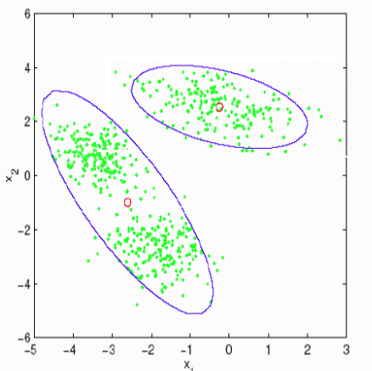
Alternative idea – let’s divide the samples into disjunct groups
Example: we want to fit a mixture of 2 Gaussians on the green points
Let’s divide the points into 2 disjunct
groups (clusters) – see the purple curves
We can perform this division using the
K-means clustering algorithm
We can now easily fit 1-1 Gaussian
on both clusters!
  Using the ML method seen in the
  previous lecture

Slide 9
The K-means algorithm
The most common clustering algorithm
  Each cluster will be represented by a centroid
Input: the data points to be clustered, the number of clusters K, and the distance functions between to points
1.step: select K data points randomly as the cluster centroids
2. step: For each data point find it cluster (i.e. the nearest centroid)
3. step: re-calculate the centroids as the mean of the data points that were assigned to that cluster
4. step: if no point changed its cluster: STOP
Else GOTO 2
Example: https://www.youtube.com/watch?v=RD0nNK51Fp8 from 3:00

Slide 10

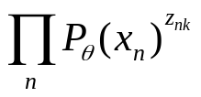

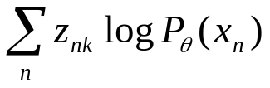
Improving the fitting of Gaussians
K-means assigned each data point to exactly one cluster
But in reality the Gaussians overlap, so one point belongs to each Gaussian to a certain extent
  We improve the Gaussian fitting step by assigning a weight to each example
  This weight will be from [0,1] and it expresses how probably the given point belongs to the given cluster
  We will call this weight z_{nk} as the ”responsibility” of the kth Gaussian for sample x_{n}
We modify the likelihood function for the kth Gaussian from to
The log-likelihood changes from to
The derivative also turns into a weighted sum instead of a sum

Slide 11

Calculating the responsibilities
The ”responsibility” z_{nk} expresses how probably sample x_{n} belongs to the kth Gaussian
How can we formalize this?
  This is simply the likelihood of the kth Gaussian normalized to [0,1]
  But it depends on μ_{k} and Σ_{k} !

Slide 12
The iterative EM training process
What do we have now?
  We can easily fit the Gaussians (estimate μ_{k} and Σ_{k} ) if the responsibilities are given
  We can easily calculate the responsibilities if the Gaussians
  (μ_{k} and Σ_{k} ) are given
We can turn it into an iterative process – the EM process
  0. step: Initialization of μ_{k} and Σ_{k} (randomly, or by K-means)
  1. step (E step or Estimation step): estimate the responsibilities
  2. step (M step or Maximization step): maximize the
  log-likelihood of each Gaussian by re-calculating μ_{k} and Σ_{k}
  Go back to step 1 (μ_{k} and Σ_{k} changed, so we must re-calculate the responsibilities!)

Slide 13
Alternative explanation
Remember that we tried to take the derivative of the log-likelihood of the mixture model, but we got stuck:
Notice that the problematic part is equivalent with what we called the “responsibility”!
  Let’s cheat, and act as if it was a constant, independent of μ_{k}!
  Then we can easily calculate the derivative and obtain a new estimate for μ_{k} (and the same will be true for Σ_{k})
  But what we obtained won’t be optimal, as we cheated
  So we re-calculate the responsibilites and repeat the whole process again (and again)
This was the problem
(it contains μ_{k})

Slide 14
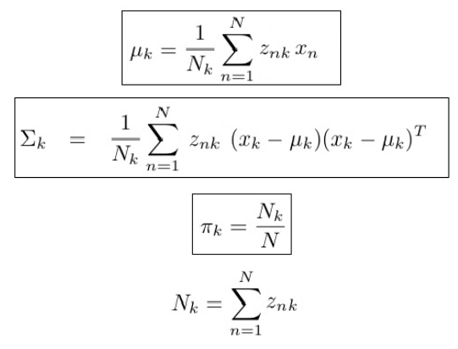
The parameter update formulas
Notice the similarity to the solution obtained for 1 Gaussian!

Slide 15
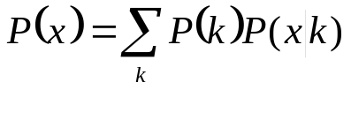
Proof of the EM algorithm
What we described is possible, but how do we know that it converges to a reasonable solution?
We will now prove that each iteration step increases the
log-likelihood value
  So the full process is guaranteed to find a local optimum
The proof we be general, so it works not only for Gaussian mixture models, but for any model that has the form
  (Notice that in the GMM the π_{k} weights were non-negative and add up to one, so we can interpret them as a discrete distribution P(k) )

Slide 16
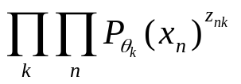
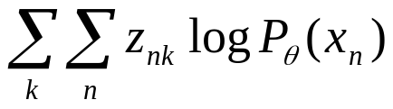
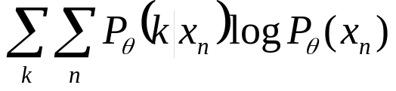
Formalizing the maximization step
So far we talked about optimizing the Gaussians separately,
i.e. we optimized the likelihood of for each Gaussian k
To be able to represent the maximization step by one formula, we optimize the product of these likelihoods
After taking the logarithm, we obtain the log-likelihood as
And remember that z_{nk} is the probability that sample x_{n} belongs to component k. In the following we will denote it as P _{θ}(k| x_{n})

Slide 17

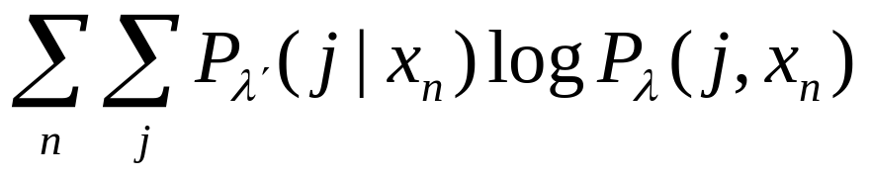
Further notational modifications
So far we denoted the parameters by θ. Now we want to analize what happens in the maximization step. To discriminate the parameters before and after the maximization step, the actual parameters will be denoted by λ’, while the new parameters obtained by maximization will be λ
The Gaussian components will be indexed by j (instead of k)
So, our final goal is to maximize the log-likelihood
But instead of this, in each iteration we maximize
  Notice that λ’ is fixed here, and λ is the variable!

Slide 18
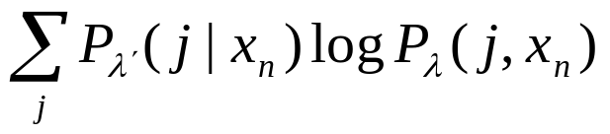


Expectation maximization
The function that we maximize in each iteration
is called the „expectation” function. We call it this way because it is the conditional expectation of the function for a given x_{n} and λ’
So, one iteration of te EM algorithm consists of to steps:
  1. Expectation (or estimation) step: calculate the
  values fog a given λ’, as we need them for the above expectation
  2. Maximization step: maximize the function with repect to λ

Slide 19
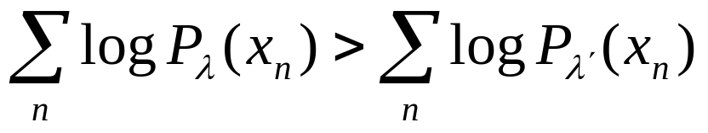
Proof of the EM algorithm
We want to maximize the log-likelihood
But instead of this, we maximize
We show that if the maximization step increased the value of the expectation function, so that for the actual λ’ and the new λ
Then
That is, if the maximization increases the expectation function then the log-likelihood function also increases

Slide 20
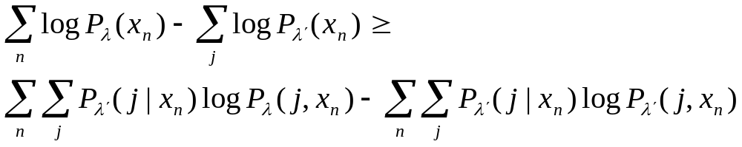
Proof (shortly)
Means that
We show that
So if the latter difference is greater than zero, than the former one is also greater than zero, which in turn means that

Slide 21
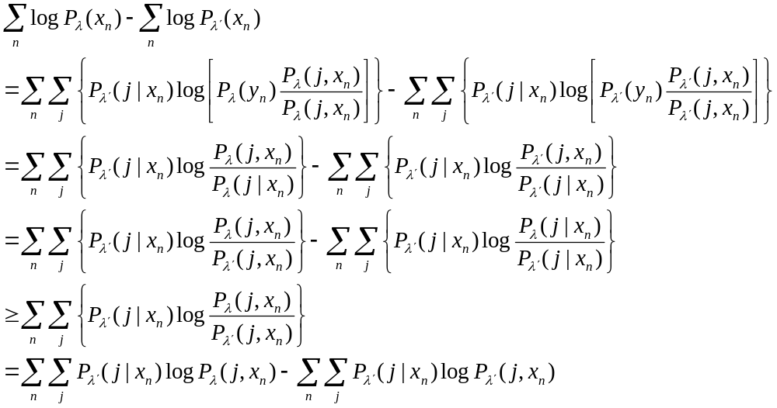
Proof (detailed)
=1
≤0 (Jensen-inequality)

Slide 22
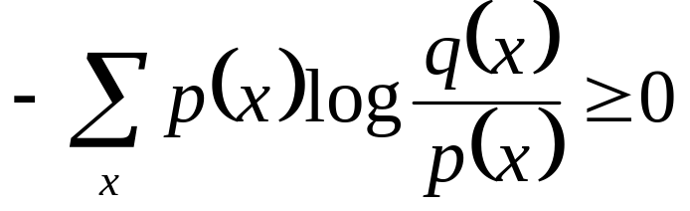
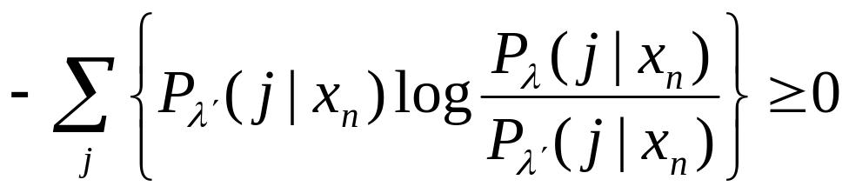
The Jensen inequality
In general, for any p(x) and q(x) distributions:
Specifically, in this case:

Slide 23
Summary – General properties of EM
It can be used to optimize any model that has the form
Instead of the log-likelihood function, it optimizes the expectation fuction
It is an iterative process
  In each iteration, given the actual parameters λ’ , it finds a new parameter set λ for which the expectation is larger (not smaller)
  It has two steps: expectation (or estimation) and maximization
  It guarantees that the log-likelihood increases (does not decrease) in each step, so it will stop in a local optimum
The actual optimization formulas should be derived for each model separately

Slide 24
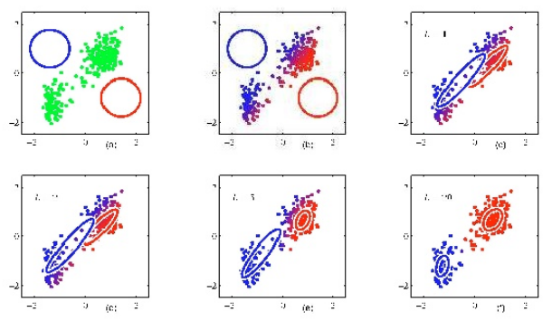
Examples
Example 1 (with random initialization):
Example 2 (with random initialization):
    https://www.youtube.com/watch?v=qMTuMa86NzU from 11:40

Slide 25
Some technical remarks
The parameters are usually initialized via K-means clustering
  It may give quite different results depending to the initial choice of the centroids
  So the clustering process is worth repeating with various initial choice (e.g. random choice) of the centroids
    Then we start the EM process with the clustering result that gives the largest initial likelihood value
  Of course, there exist more sophisticated methods to initialize the centroids

Slide 26
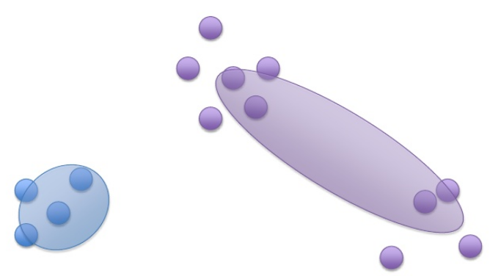
Technical remarks 2
We assumed that the number of Gaussians per class (parameter k) was given ahead
Is it possible to find the optimal value automatically?
  The simplest solution is: try to use 1, 2, 3,… Gaussians
  Chose the one that gives the largest likelihood
What kind of error may occur if k is too small?
  The algorithm runs, but it gives a suboptimal solution

Slide 27
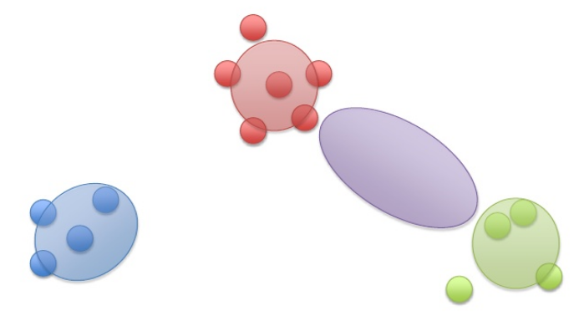
Technical remarks 3
What happens if k is too large?
  One cluster or clusters become empty
  The same happens of a cluster contains too few data points → the covariance matrix becomes non-invertible → singularity problem
    e.g.: what is the variance of 1 sample?
  This makes the algorithm very sensitive to outliers

Slide 28
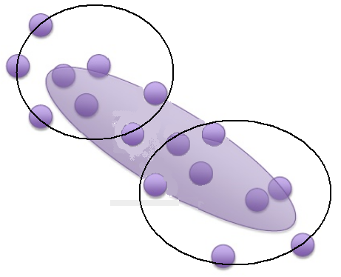
Technical remarks 4
In practice, we frequently restrict the Gaussian components to have diagonal covariance matrices
  Singularity happens with a smaller chance
  Computations becomes much faster
    In each iteration we must re-estimate the covariance matrix
    and take its inverse → it is much faster with diagonal matrices
  We can alleviate the model mismatch problem by increasing the number of Gaussians

